Slide 1

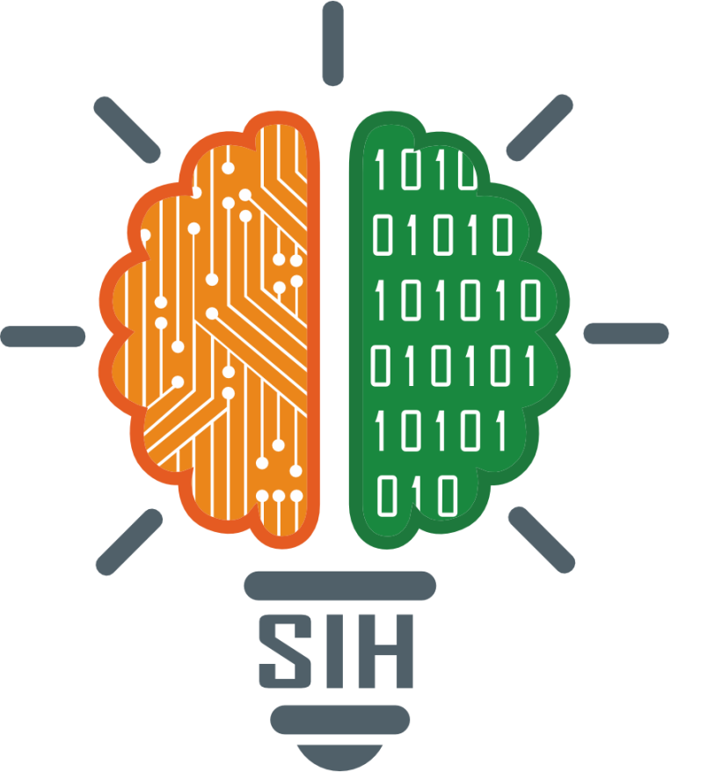
SMART INDIA HACKATHON 2024
TITLE PAGE
Problem Statement ID – 1724
Problem Statement Title - Platform for Inter-departmental cooperation in Indian Cities, for sharing data & resources, unified phasing, planning and implementation of projects.
Theme – Miscellaneous
PS Category- Software
Team ID -
Team Name (Registered on portal) – Team Hexa Syndicate

Slide 2
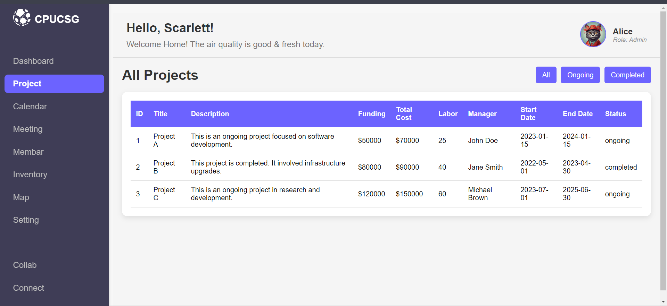
Interdepartmental Digital Platform for Urban Governance
Team Hexa Syndicate 2.0
A advanced digital system called the Interdepartmental Digital Platform was created to make it easier for different local government departments to work together smoothly. It consists of:
Centralized Dashboard Offers a cohesive perspective of current and future projects, distribution of resources, and cross-departmental assignments.
The data exchange module allows departments to share resources, technological know-how, and data in real-time.
Project management tools Provides functionality for work distribution, reporting, and task scheduling to efficiently manage cross-departmental projects.
Collaborative Area Coordinated conversation spaces for public, departmental, and interdepartmental engagement.
Training and Capacity Building Workshop, seminar, and training session modules to improve knowledge and abilities.

Slide 3
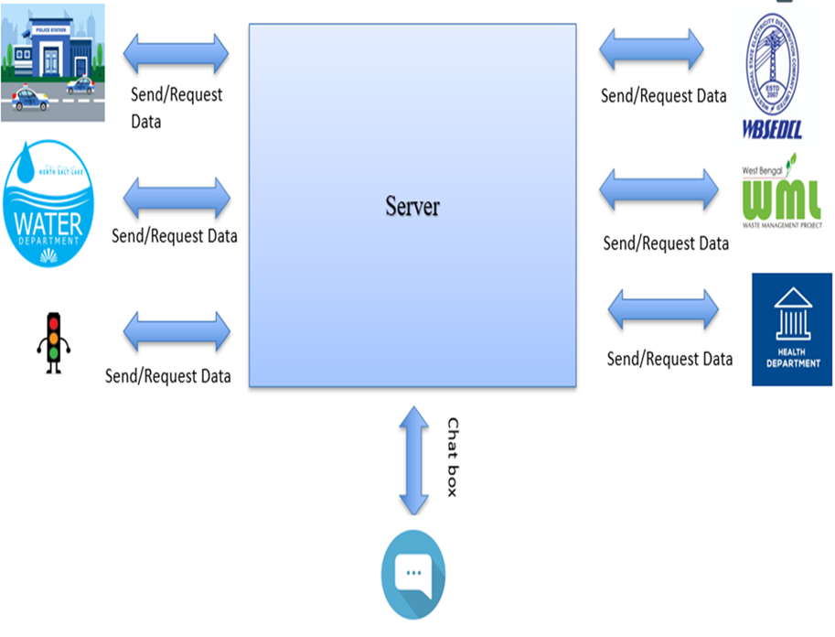
TECHNICAL APPROACH
Team Hexa Syndicate 2.0
Frontend Design: https://optimas-cse23l197.github.io/CPUCSG/
Technologies to be Used:
Frontend: React.js , CSS
Backend: Java
Database: MySQL, MongoDB
Cloud Infrastructure: Google Cloud
Collaboration Tools: Microsoft Teams API
Hardware: Servers, Mobile Devices, Laptops
Methodology & Process for Implementation:
Planning Phase: Stakeholder Mapping, Requirements Gathering
Design Phase: System Architecture Design, Wireframes
Development Phase: Frontend & Backend Development, API Integration
Testing & Integration: Prototype Testing, User Testing
Deployment & Training: Phased Deployment, Training Sessions

Slide 4
FEASIBILITY AND VIABILITY
Team Hexa Syndicate 2.0

Slide 5
IMPACT AND BENEFITS
Team Hexa Syndicate 2.0
The establishment of a platform for inter-departmental collaboration in Indian cities, with the goal of sharing data and resources for cohesive planning and execution of projects, can have a revolutionary impact. Here's a breakdown of the key benefits:
1. Improved Coordination and Productivity Efficient Communication: The platform enables seamless communication among different departments (transportation, urban planning, health, education, etc.), leading to faster decision-making and minimized delays. Reduction of Redundancy: By sharing data and resources, departments can avoid duplicative work and allocate resources more efficiently.
2. Unified Planning and Phasing Collaborative Project Execution: Departments can work together on projects with a unified vision, ensuring that transportation, utilities, housing, and other critical infrastructure are planned in a coordinated manner. Optimized Resource Allocation: With shared data, decision-makers can allocate budgets, resources, and manpower more judiciously, ensuring that urban projects are phased and implemented optimally.
3. Data-Driven Decision Making Real-time Data Exchange: Departments can share real-time data on traffic, pollution, water supply, public health, etc., allowing them to adapt plans to emerging challenges.Evidence-Based Planning: Analysis of historical data can guide long-term strategies and support evidence-based policies for urban development, ensuring a sustainable and efficient growth trajectory.
4. Increased Transparency and Accountability Monitoring and Reporting: A shared platform improves project tracking, making it easier for all stakeholders to monitor progress and identify bottlenecks early on. Public Accountability: Enhanced transparency in decision-making, resource allocation, and project execution can improve public trust and reduce instances of corruption.
5. Enhanced Service Delivery Citizen-Focused Solutions: Integrated departments can better design services that cater to the population’s needs, including waste management, traffic regulation, and emergency services. Reduction in Service Disruptions: Unified planning can help avoid conflicts in scheduling and reduce disruptions to public services (e.g., digging roads multiple times for different projects).6. Cost-Efficient PracticesLeveraging Economies of Scale: Joint procurement of resources, such as materials and services, can lead to bulk purchasing discounts and cost efficiencies.Minimized Project Delays: Better coordination minimizes delays, reducing the overall cost of project completion and ensuring timely delivery of benefits to citizens.7. Sustainability and Environmental Advantages Comprehensive Urban Planning: Coordinated efforts can lead to more environmentally sustainable projects, such as integrated public transport systems or energy-efficient urban infrastructure.Resource Optimization: Shared resources and data prevent wastage and promote sustainable urban growth, particularly important in densely populated cities.

Slide 6
RESEARCH AND REFERENCES
Team Hexa Syndicate
References
Townsend, Anthony M. (2013). Smart Cities: Big Data, Civic Hackers, and the Quest for a New Utopia. W.W. Norton & Company.
West, Darrell M. (2005). Digital Government: Technology and Public Sector Performance. Princeton University Press.
Gartner. (2024). Digital Transformation in Government: Insights and Trends. Gartner.
https://en.wikipedia.org/wiki/Urban_planning
https://www.worldbank.org/en/topic/urbandevelopment/overview
https://www.britannica.com/topic/urban-planning
Government and Institutional Case Studies
"Case Studies on Smart City Implementations" from local governments
Many cities publish case studies or reports on their smart city initiatives, detailing the use of digital platforms for improving governance.

